Slide 1
United States Housing Market
Data Analytics Bootcamp – Project 1
November 12, 2024
Amy Johnson
Seth Carter
Eduardo Camacho
Rafaela Peterson

Slide 2
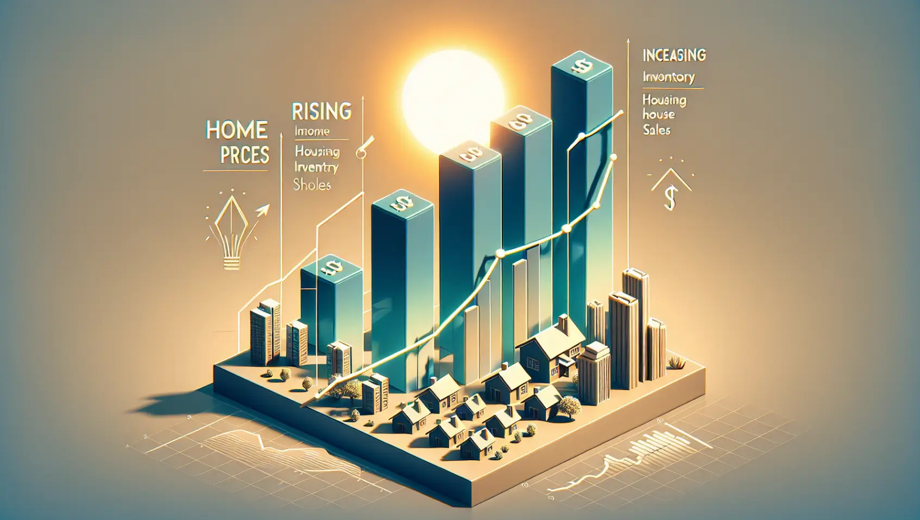
What are the trends with the housing market?
Datasets were analyzed to determine trends and examine relationships between United States Median House Price and:
Median Household Income
Inflation Rate
Interest Rates
Population Growth
Housing Inventory
Unemployment Rate

Slide 3
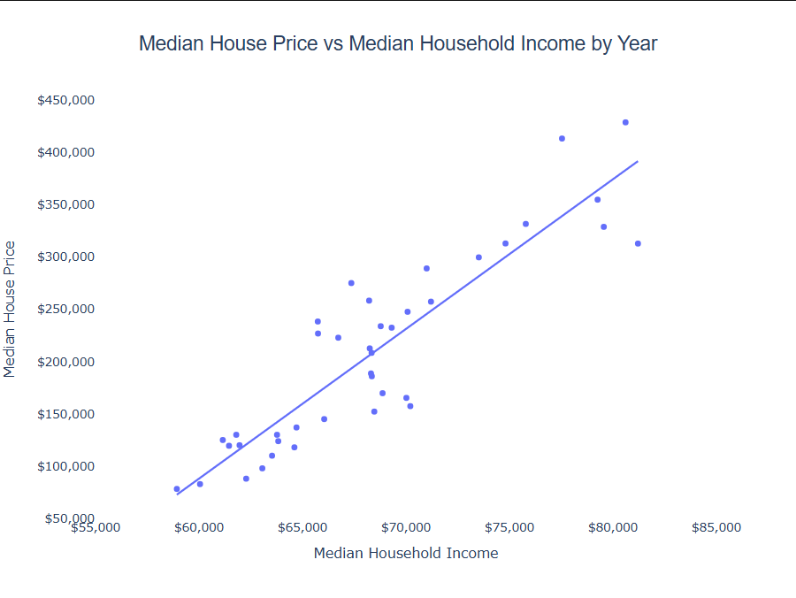
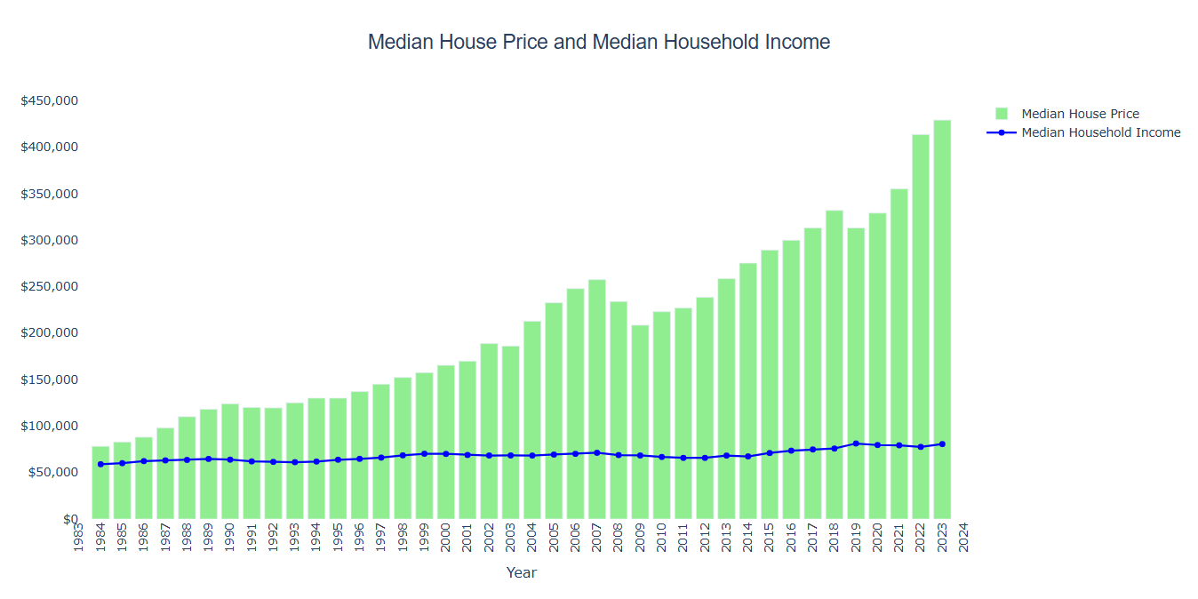
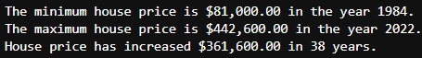
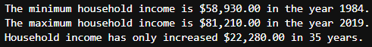
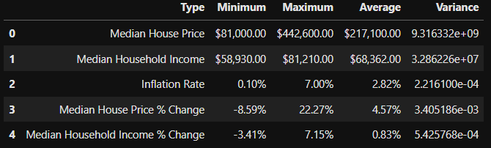
United States Median House Price vs Median Household Income
Median Household Income does not increase at the same rate as Median House Price in the United States year over year
Median House Prices may dip slightly from time to time, but looking at the greater picture overall, it always trends upwards
Median Home Prices increase year or year and then dip a bit just for a couple of years like in years 2008-2009 and 2018-2019
It seems that we may be seeing that same trend in 2023-2024 since Median House Prices dipped from 2022
Seeing how that trend has repeated itself, I'd guess that in 2024-2025 would be a good time to buy a house
There is a positive relationship with Median House Price and Median Household Income in the United States.
As Median House Price increases, so does the Median Household Income year over year.

Slide 4
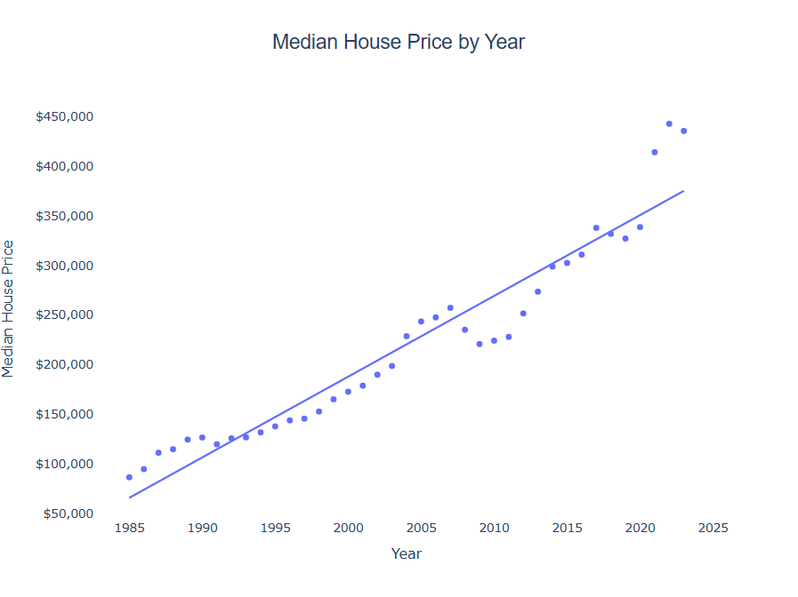
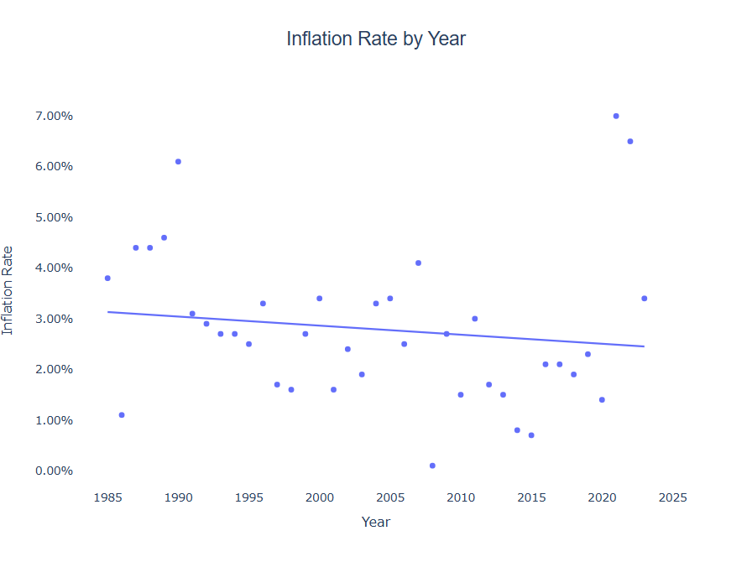
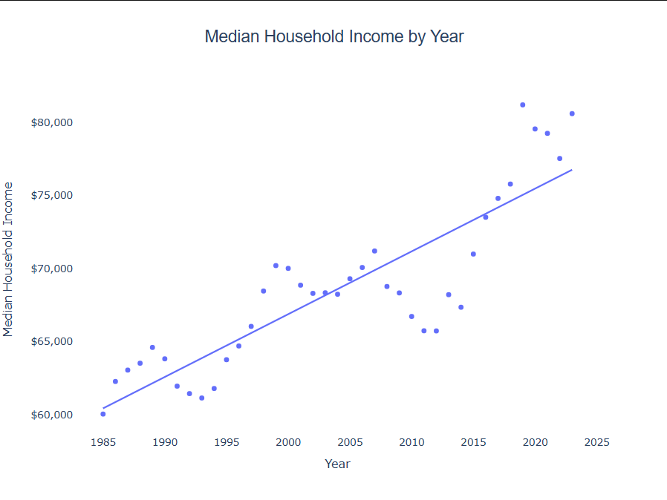
Backup Data
There is a VERY strong analysis with Median House Price and Year and a slight ongoing pattern of increasing for a few years and then decreasing the following years before increasing again
Median Household Income by Year also shows a similar trend, but not as strong
There is actually a slight negative relationship with Inflation Rate and Year, but not very strong and quite a few outliers

Slide 5
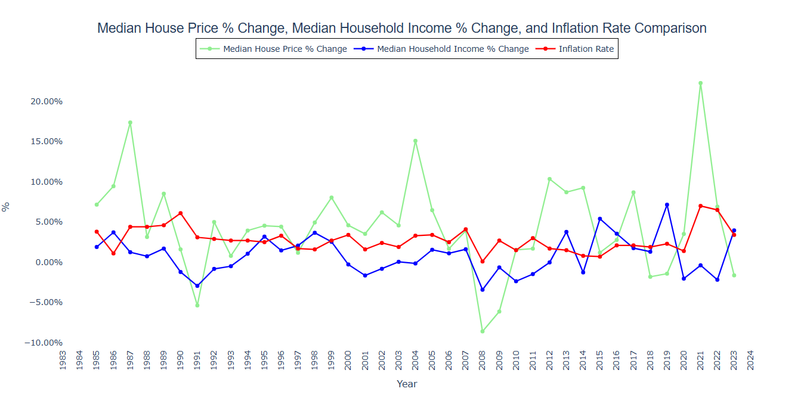
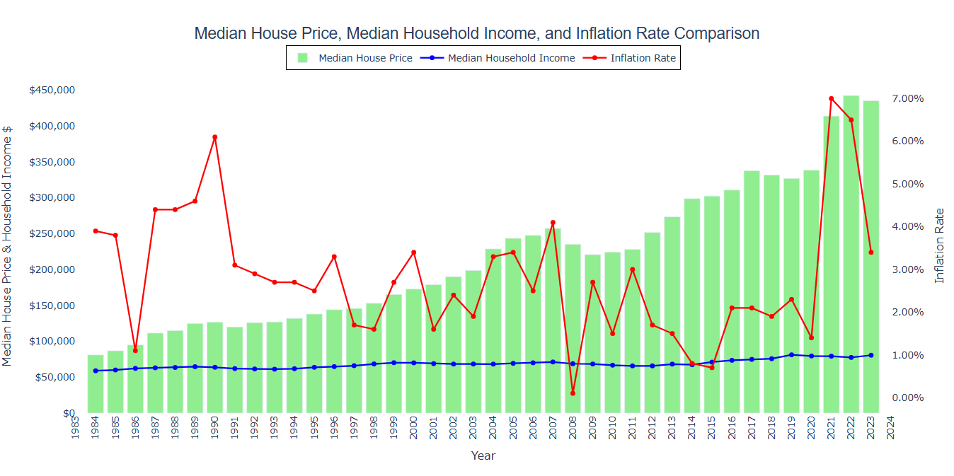
United States Median House Price plus Inflation
Median House Price % Change fluctuates quite a bit year to year, majority of the time still a positive % increase.
There were four years that had a 10%+ increase in house price, 1987-1988 with a 17.37% increase, 2004-2005 with a 15.09% increase, 2012-2013 with a 10.35% increase, and 2021-2022 with the highest increase of them all at 22.27%.
A few years later on those high % increases were pretty low % decreases with 1991-1992 with a -5.36% decrease, 2008-2009 and 2009-2010 with -8.59% and -6.12% decreases, respectively, 2018-2019 and 2019-2020 with -1.81% and -1.42% decreases, respectively, and 2023-2024 with a -1.63% decrease.
Median Household Income % Change also fluctuates a bit, but has more minimal change year to year than Median House Price.
There were a lot more years where the Median Household Income decreased from the previous year than compared to the Median House Price which tells us that even though the Household Income went down, House Prices still increased in many years.
For example, between the years 2020-2021, the Median Household Income decreased -2.03%, but Median House Prices increased 3.52%.
However, both follow the same positive or negative trend majority of the time.
This graph is the same as the graph showing the trend in Median House Price and Median Household Income year over year, but each year's inflation rate is added
Inflation rate varies significantly from year to year and there is no pattern with the trend like there is for Median House Price and Median Household Income
The lowest the inflation rate has ever been was 0.10% in 2008 and the highest was 7.00% in 2021 with an average from 1984-2023 of 2.82%.

Slide 6
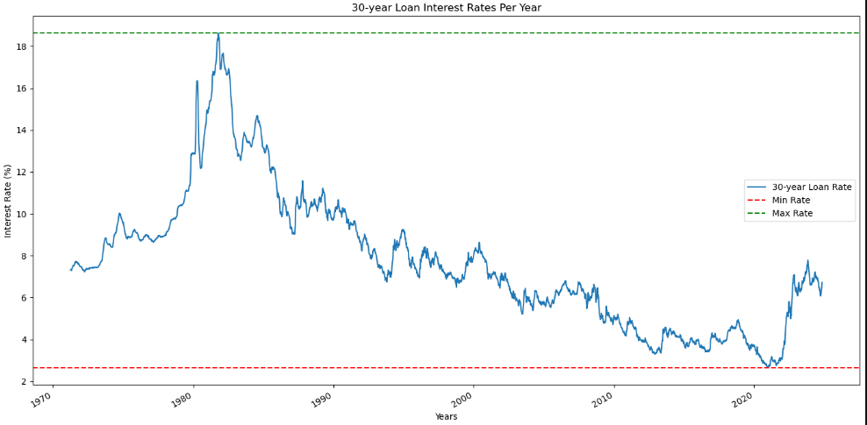
United States Home Interest Rates
Highest Rate:
10/9/1981: 18.63%
Lowest Rate:
1/7/2021: 2.65%

Slide 7
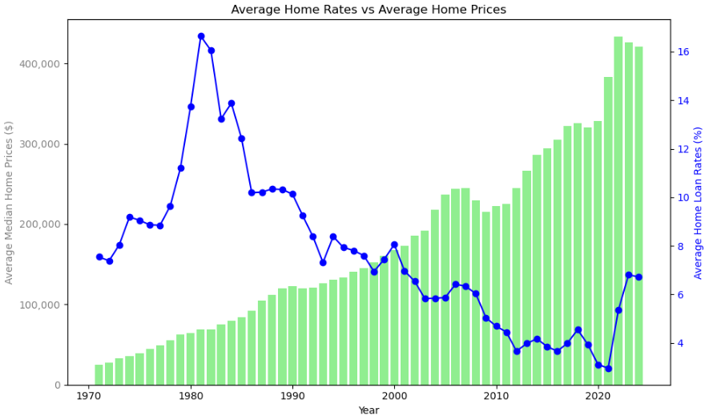
United States Median House Price vs Interest Rates

Slide 8
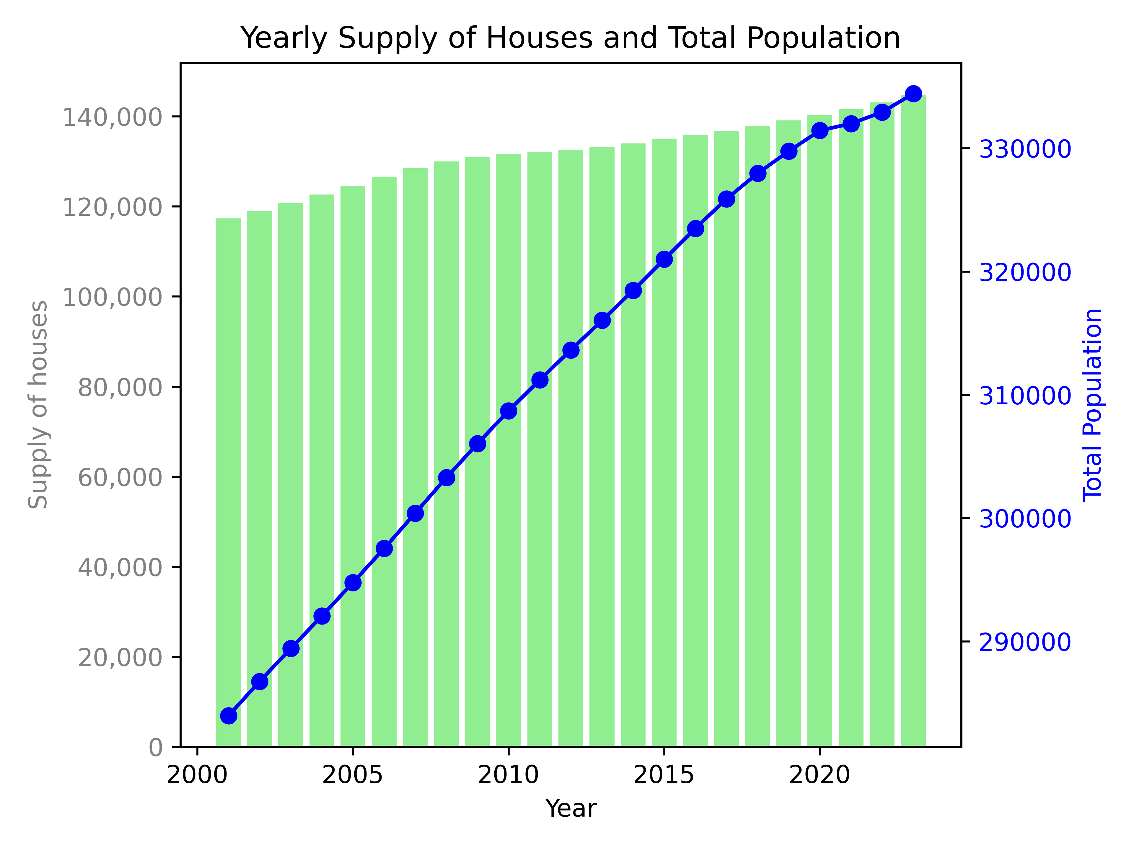
Supply of Houses and Total Population

Slide 9
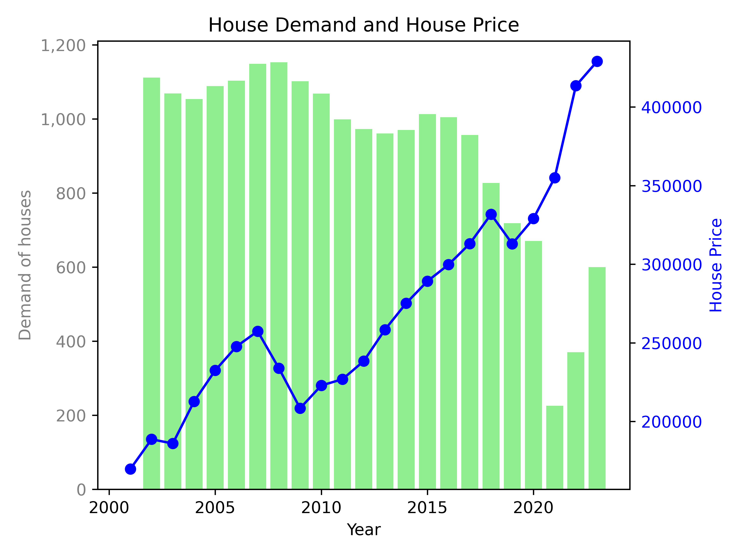
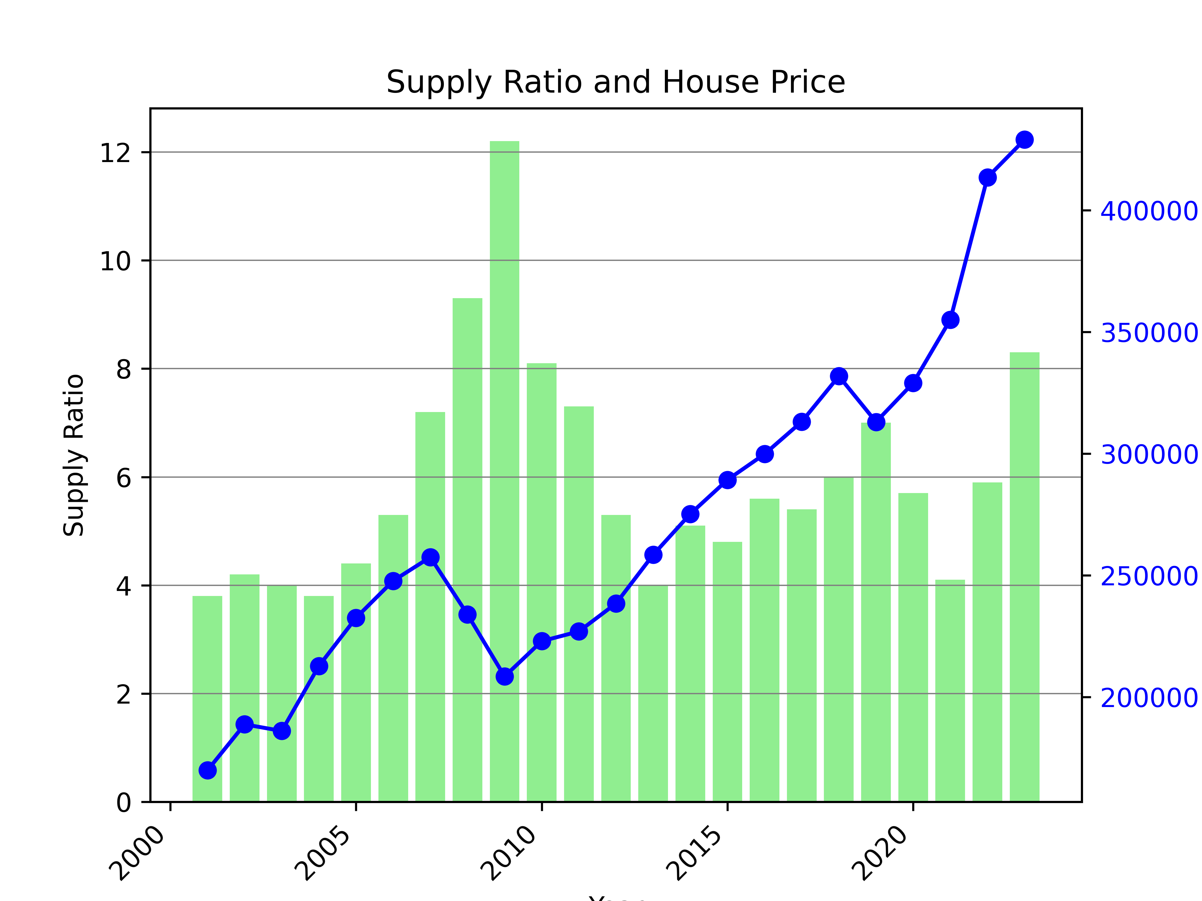
House Price vs Supply and Demand

Slide 10
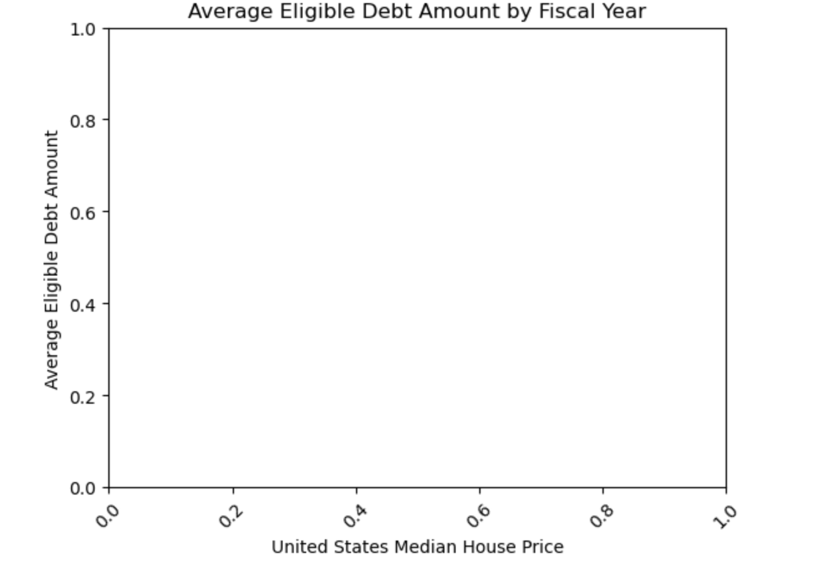
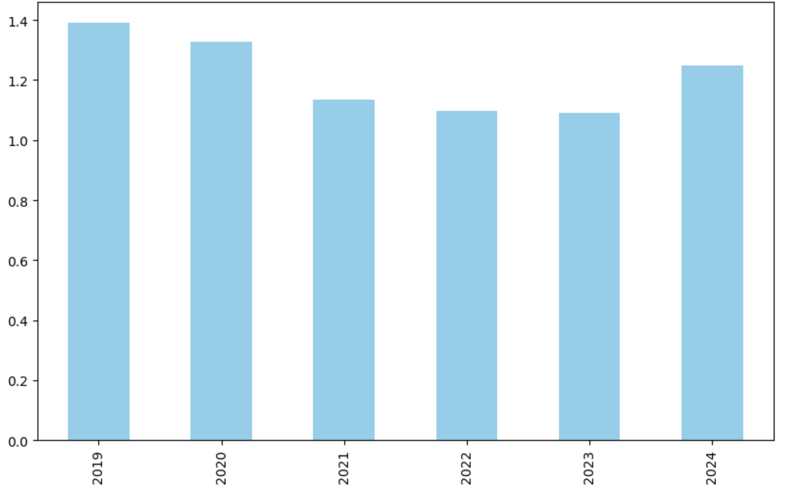
United States Median House Price vs Unemployment

